Slide 1
COMP 2310 Data Structures and Algorithms
Lecture 12
Sub-quadratic time Sort Algorithms
Merge sort
Quicksort
Counting Sort

Slide 2
How Fast Can We Sort?
Can we sort in subquadratic times?
Sub Quadratic means having a Big O better than O(N²)
An observation: all of the sorting algorithms so far are comparison sorts
The only operation used to gain ordering information about a sequence is the pairwise comparison of two elements

Slide 3
A Solution Design Strategy: Divide-and-Conquer
Very important algorithm design strategy in computer science:
Divide the problem into a number of sub-problems
Obtain similar sub-problems of smaller size
Conquer the sub-problems
Solve the sub-problems recursively
When Sub-problem size small enough
⇒ solve the problems in straightforward manner
Combine the solutions of the sub-problems
Obtain the solution for the original problem

Slide 4
Sorting by Divide and Conquer
Sorting an array:
Divide array into two halves,
recursively sort left and right halves,
Then combine two halves
Examples: Mergesort and Quicksort
Both are sub-quadratic (better than O(n²)) sort algorithms.

Slide 5
Merge Sort
Divide the unsorted array into 2 halves until each sub-array contains only one element
Then merge the sub-arrays together:
Merging sub-arrays of an array:
Compare first elements of two sub-arrays
Remove the smallest element and put it into first sort position of the array
Continue the process until all elements of sub arrays have been sorted.

Slide 6
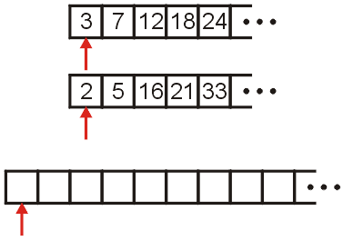
Merge Operation
Consider two already sorted arrays and an empty array(Result)
Assume array sizes are n1, n2
→ n = n1+n2
Define three indices at the start of each array

Slide 7
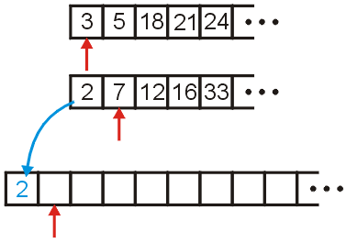
Merging Example
We compare 2 and 3: 2 < 3
Copy 2 down to the result array
Increment the corresponding indices

Slide 8
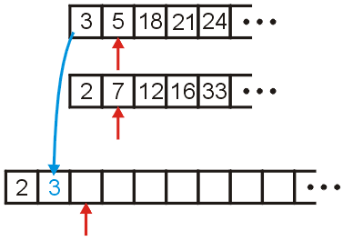
Merging Example
We compare 3 and 7
Copy 3 down
Increment the corresponding indices
Continue until both lists have been transferred into the result array.
Time complexity of merging: T(n) = n1+n2
= O(n)

Slide 9
Merge Algorithm
MERGE(A, p, q, r) merges two subarrays of a given array:
A: A[p…q] and A[q+1…r], p……………….q q+1…………r assuming that they are already sorted.
Green and blue parts below are already sorted: A = (…A[p],….,A[q], A[q+1],…A[r]…)
→Merge green and blue parts.
Example : p=9, q=12, r=16
indexes : 9……12 13…..16
A= (…,2,4,5,7, 1,2,3,6,… )
MERGE (A,9,12, 13,16)

Slide 10
Merge Algorithm
Informal Method:
Continue with the example
1.Define two subarrays L and R of sizes:
n1=q-p+1=4 and n2= r-q =4
2.Move the elements from A into L and R:
L= (2,4,5,7,∞) R= (1,2,3,6,∞)
3.Using two indices i and j, compare the values in L and R and move the smaller one before larger one inside A (Merge operation).

Slide 11
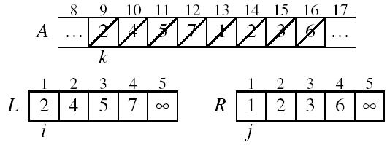
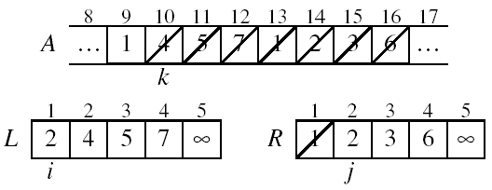
Example: MERGE(A, 9, 12, 13,16)
p
q
r

Slide 12
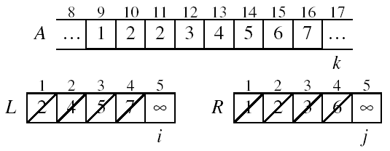
Example: Array A After merging
Done!
A is sorted from 9 to 16!

Slide 13
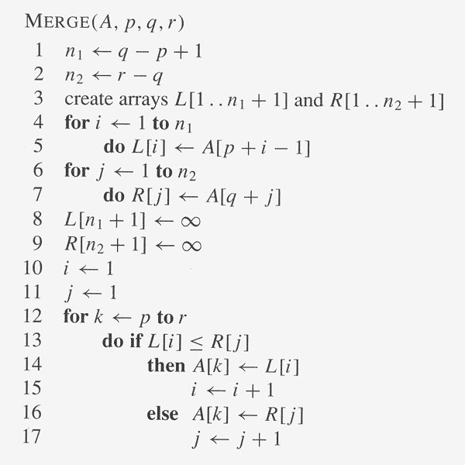
Merge Algorithm for Subarrays MERGE(A, p, q, r) merges subarrays A[p..q] and A[q+1..r] so that this part of A becomes sorted.
//

Slide 14
Merge Sort
Mergesort is based on successive merges of subarrays.
Strategy:
Step 1: Divide the array into sub-arrays, until only one element remains in each.
Step 2: Merge the sub-arrays upwards
Notice that merge sort is a recursive solution, so a recursive algorithm can be used to implement it.
Notes:
14

Slide 15
Mergesort: Example-1
N=8, power of 2
6 | 3 | 9 | 1 | 5 | 4 | 7 | 2
6 | 3 | 9 | 1
Divide
5 | 4 | 7 | 2
divide
divide
6 | 3
9 | 1
5 | 4
7 | 2
divide
divide
divide
divide
6
3
9
1
Conquer
5
4
7
2
merge
merge
merge
merge
3 | 6
1 | 9
4 | 5
2 | 7
merge
merge
1 | 3 | 6 | 9
2 | 4 | 5 | 7
merge
1 | 2 | 3 | 4 | 5 | 6 | 7 | 9
Sorted!
Notes:
15

Slide 16
Mergesort Example 2: n=11, not a Power of 2
Divide
1
2
3
4
5
6
7
8
9
10
11
4
7
2
6
1
4
7
3
5
2
6
q = 6
1
2
3
4
5
6
7
8
9
10
11
q = 3
4
7
2
6
1
4
7
3
5
2
6
q = 9
1
2
3
4
5
6
7
8
9
10
11
4
7
2
6
1
4
7
3
5
2
6
1
2
3
4
5
6
7
8
9
10
11
4
7
2
6
1
4
7
3
5
2
6
1
2
4
5
7
8
4
7
6
1
7
3

Slide 17
Example 2: n Not a Power of 2
Conquer:
Merge
1
2
3
4
5
6
7
8
9
10
11
1
2
2
3
4
4
5
6
6
7
7
Sorted
1
2
3
4
5
6
7
8
9
10
11
1
2
4
4
6
7
2
3
5
6
7
1
2
3
4
5
6
7
8
9
10
11
2
4
7
1
4
6
3
5
7
2
6
1
2
3
4
5
6
7
8
9
10
11
4
7
2
1
6
4
3
7
5
2
6
1
2
4
5
7
8
4
7
6
1
7
3

Slide 18
Recursive Merge Sort Algorithm
The recursive algorithm performs successive merge operations A: The array to be sorted. The size is n. p, r: First and last index values (int) that are used in merges
p
q
r
1
2
3
4
5
6
7
8
5
2
4
7
1
3
2
6
MERGE-SORT(A, p, r) if p < r // base case then q ← ⎣(p + r)/2⎦ //Divide
MERGE-SORT(A, p, q) //Conquer
MERGE-SORT(A, q + 1, r) //Conquer
MERGE(A, p, q, r) //Combine
Initial call: MERGE-SORT(A, 1, n)

Slide 19
Tracing Merge Sort on array A = 4 3 1 2
n=4, p=1, r=4
Initial call: MERGE_SORT(A,1,4)
4 3 1 2 MergeSort(1,4)
4 3 MergeSort(1,2)
4 MergeSort(1,1)
3 MergeSort(2,2)
3 4 Merge(1,1,2)
1 2 MergeSort(3,4)
1 MergeSort(3,3)
2 MergeSort(4.4)
1 2 Merge(3,4,4)
1 2 3 4 Merge(1,2,4)

Slide 20
Merge Sort Complexity: Recursion Tree Method Sublist sizes Total List Sizes
Notes:
20

Slide 21
Merge Sort: Complexity
O(n log n) worst-case running time.
Same operations have to be done regardless of input order
→The average and best cases are also O(nlogn)
Additional cost: Copying to and from temporary array
Extra memory requirement
Extra work
Notes:
21

Slide 22
Quick Sort
Proposed in 1962.
A simple and practical in place sort algorithm.
A divide and conquer algorithm (like merge sort)
It can be implemented as an iterative or recursive algorithm
Notes:
22

Slide 23
Quick Sort: How it works ?
Quick-sort is based on the divide-and-conquer paradigm:
Divide: pick an element x called pivot, partition S into
L elements less than x
E element equals x
G elements greater than x
X is in correct location
Recursion: sort L and G
Conquer: join L, E and G
x
x
L
G
E
x
Finally

Slide 24
Recursive Quicksort: Description
To sort A[left...right]:
1. if left < right:
1.1. Partition A[left...right] such that:
all A[left...p-1] are less than A[p], and
all A[p+1...right] are >= A[p]
1.2. Quicksort A[left...p-1]
1.3. Quicksort A[p+1...right]
2. Terminate

Slide 25
Recursive Quick Sort: Partitioning
Choose an array value (say, the first or last) to use as the pivot: p
Use two indexes for moves forward from left and backward from right.
Starting from the left end, find the first element that is greater than or equal the pivot
Searching backward from the right end, find the first element that is less than the pivot
Swap these two elements
Repeat, searching from where we left off, until the indexes cross(Left>right): Swap the pivot with last left index value.
→The pivot now is in its correct position
Left index→ ←right index
p
numbers less than p
p
numbers greater than or equal to p

Slide 26
Example of Partitioning Assume we have two indexes: left: Moves forward from left to right, right: Moves backward from right to left
choose pivot: 4 3 6 9 2 4 3 1 2 1 8 9 3 5 6 pivot=4
search: 4 3 6 9 2 4 3 1 2 1 8 9 3 5 6 left right moves:6 bigger, 3 smaller
Swap (6 and 3) 4 3 3 9 2 4 3 1 2 1 8 9 6 5 6 swap(exchange) 6 and 3
search: 4 3 3 9 2 4 3 1 2 1 8 9 6 5 6 9 is bigger, 1 is smaller
Swap (9 and 1) 4 3 3 1 2 4 3 1 2 9 8 9 6 5 6
search: 4 3 3 1 2 4 3 1 2 9 8 9 6 5 6
Swap (2 and 4) 4 3 3 1 2 2 3 1 4 9 8 9 6 5 6
search: 4 3 3 1 2 2 3 1 4 9 8 9 6 5 6 (left > right: Stop)
swap with pivot 1 3 3 1 2 2 3 4 4 9 8 9 6 5 6 (1 and 4)
The pivot, 4, is now in its correct position.
For sorting recursively: Continue on left and right partitions.

Slide 27
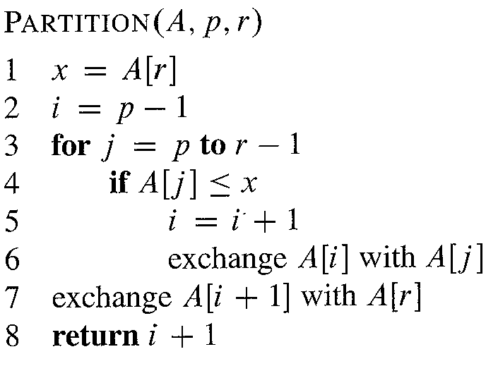
Pseudocode for Partitioning i: left index, j: right index. x: pivot (last element, could be another) Output: Final position of the pivot in the array
Running time : O(n) for n elements.

Slide 28
Pseudocode for Partitioning (More detailed form)
/* The function takes last element as pivot, places the pivot element at its correct position in sorted array, places all smaller to left of pivot and all greater elements to right of pivot */
partition (arr[], low, high) { pivot = arr[high];
i = (low – 1) // Index of smaller element for (j = low; j <= high-1; j++)
{
// If current element is smaller than the pivot if (arr[j] < pivot)
{ i++; // increment index of smaller element swap arr[i] and arr[j] //Exchange } } swap arr[i + 1] and arr[high]) //Pivot in its final position return (i + 1) }

Slide 29
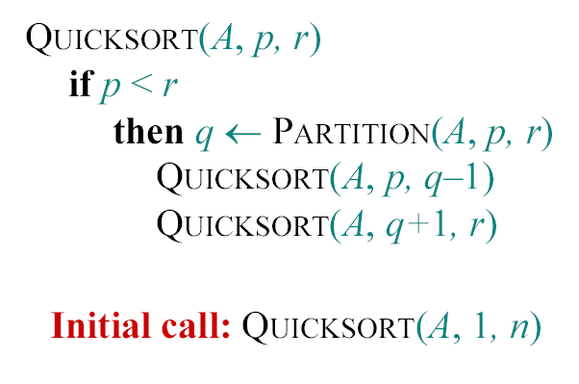
Recursive Pseudo Code for Quicksort

Slide 30
Illustration: Recursive Quick Sort A=2 8 7 1 3 5 6 4 , p=1, r=8. Assume pivot is the last element. Initial call: Quicksort(A,1,8). In each call, find the final position of pivot
2 | 8 | 7 | 1 | 3 | 5 | 6 | 4
2 | 1 | 3 | 4 | 7 | 5 | 6 | 8
First partitioning
Sort left side
Sort right side
Sorted
2 | 1 | 3 | 4 | 7 | 5 | 6 | 8
1 | 2 | 3 | 4 | 7 | 5 | 6 | 8
1 | 2 | 3
4
7 | 5 | 6 | 8
1 | 2 | 3
4
7 | 5 | 6 | 8
1 | 2 | 3
4
5 | 6 | 7 | 8
1 | 2 | 3
4
5 | 6 | 7 | 8
Notes:
30

Slide 31
Time Complexity of Quicksort: Worst case
In the worst case, partitioning always divides the size n array into three parts:
A length one part, containing the pivot itself
A length zero part, and
A length n-1 part, containing everything else
We don’t recur on the zero-length part
Recurring on the length n-1 parts require handling sublists of size n-1 each time.
When does this happen?
When the array is already sorted
When the array is inversely sorted (sorted in the opposite order)

Slide 32
Time Complexity of Quicksort: Worst case
The worst case for quick-sort occurs when the pivot is always the unique minimum or maximum element
One of partitions has size n − 1 and the other has size 0
→The running time is proportional to the sum
T(n)= n + (n − 1) + … + 2 + 1 = n(n+1)/2
Thus, the worst-case complexity of quick-sort is O(n²)
depth | Size
0 | n
1 | n − 1
… | …
n − 1 | 1
…

Slide 33
Time Complexity of Quicksort: Best case
We cut the array size in half each time
So the depth of the recursion in log₂n
At each level of the recursion, all the partitions at that level do work (comparisons, swaps) that is linear in n
T(n)=log₂n * n
= O(n log₂n)
Hence in the best case, quicksort has time complexity O(n log₂n)
This can also be seen from the recursion tree

Slide 34
Recursion Tree for Best Case
Partition Comparisons
Nodes contain problem size
n
n
n
n/2
n/2
n/4
n/4
n/4
n/4
n
n/8
n/8
n/8
n/8
n/8
n/8
n/8
n/8
n
. . >
. . >
. . >
. . >
………………………………………………………………………………………………..
T(n)= n log₂n
= O(n logn)

Slide 35
Average (Typical) Case
If the array is sorted or nearly sorted to begin with, Quicksort is no better than an inefficient sort: O(n²)
It is possible to construct other bad cases, but it can be shown that the average case running time is close to the best case:
~O(nlogn)
The constants in the complexity equation are so good that Quicksort is the fastest algorithm for average case.
Most real-world sorting is done by Quicksort

Slide 36
Quicksort for Small Arrays
For small arrays, quicksort does not perform as well as insertion sort
How small depends on many factors, such as the time spent making a recursive call, the compiler, etc.
Do not use quicksort recursively for small data sets.
Quicksort has too much overhead for small array sizes
Instead, use a sorting algorithm that is efficient for small arrays, such as insertion sort.
Switching to insertion sort for small arrays can save about 15% in the running time

Slide 37
Improving Quicksort
Almost anything you can try to “improve” Quicksort will actually slow it down.
One possibility is to pick a better Pivot. But how?
If we can always pick a pivot value that exactly cuts the array in half:
This value is called the median: half of the values in the array are larger, half are smaller
The easiest way to find the median is to sort the array and pick the value in the middle (!)

Slide 38
Median of Three
Obviously, it doesn’t make sense to sort the array in order to find the median to use as a pivot.
Instead, compare just three elements of our (sub)arrays: First, last, and middle
Take the median of these three as pivot
Suppose we rearrange (sort) these three numbers so that the smallest is in the first position, the largest in the last position, and the other in the middle
This simplifies and speeds up the partition loop.

Slide 39
Comments
Quicksort is the fastest known sorting algorithm
For optimum efficiency, the pivot must be chosen carefully
Median value is a good choice for pivot
However there will be additional overhead for finding the median each time.
On the other hand, although rare, there will be some cases where Quicksort runs in nearly O(n²) time
Remember that we have to repeat this for every subarray!
→Costly

Slide 40
Which sort method ?
For very small arrays, quicksort does not perform as well as insertion sort.
Switching to insertion sort for small data sets is a better option.
In C++, copying objects can be expensive while comparing objects often is relatively cheap. Therefore, quicksort is the sorting routine commonly used in C++ libraries.
Commercial Database Management systems like Oracle, MS SQLServer… use variations of quick sort for sorting large files.

Slide 41
Complexity Lower Bound for Sorting
All sort algorithms introduced so far are comparison based algorithms.
Under general conditions the best sorting algorithms have an asymptotic running time of O(n log n)
This is the lower bound for comparison based sorting!
Although bad algorithms have O(n²) complexities, difference is not appreciable for small (a few thousand) input sizes.
Quick sort is the common choice for computational problems and software that require sorting.
Notes:
41

Slide 42
Linear Time Sorting
Is it possible to sort in linear time O(n)?
→Can we do better than O(nlogn)?
For small numbers of inputs the answer is YES !
There are a few O(n) time algorithms for specific data sets.
We are going to consider counting sort as an example.

Slide 43
Counting Sort
Linear time sort method for relatively small numbers of inputs.
It is not a comparison sort
Assumption: input are integers in the range 0..k
No comparisons made!
Basic idea:
Determine for each input element x its rank: the number of elements less than x.
Once we know the rank r of x, we can move it in its correct position.

Slide 44
Counting Sort: Description
Input: A[1..n], where A[j] ∈ {1, 2, 3, …, k}
Output: sorted array B (not sorted in place)
Also: Array C[1..k] is needed for auxiliary storage

Slide 45
Counting Sort: Algorithm
countingSort(array, n)
find max in array
//Declare and initialize count array with all zeros
for i = 0 to max do
count[i] = 0
for j = 0 to n do //Counts
count[array[j]] = count[array[j]] + 1 //Histogram !
for i =1 to max
// find the cumulative sum and store it in count array
count[i] =count[i]+ count[i - 1]
for j =n down to 1
restore the elements to array
decrease count by 1 of each element restored

Slide 46
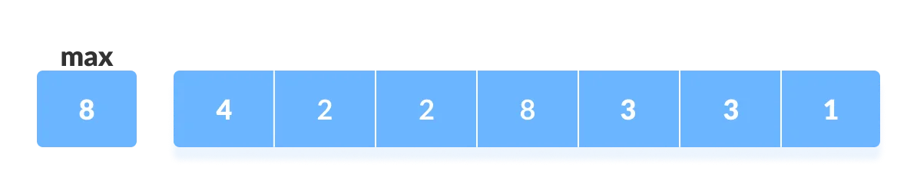
Counting Sort: Example
Array contents : 4 2 2 8 3 3 1
Step-1: Find the maximum element from the given array

Slide 47
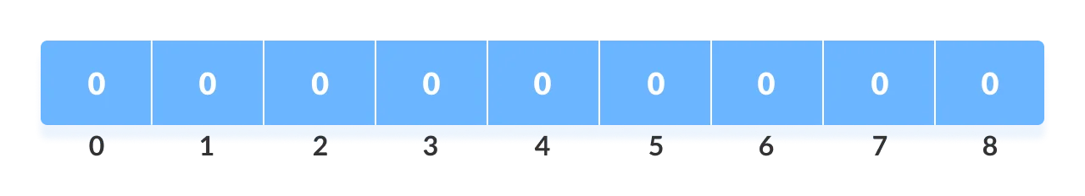
Counting Sort: Example
Step-2: Initialize an array of length max+1 with all elements 0. This array is used for storing the count of the elements in the array.
Count array:

Slide 48
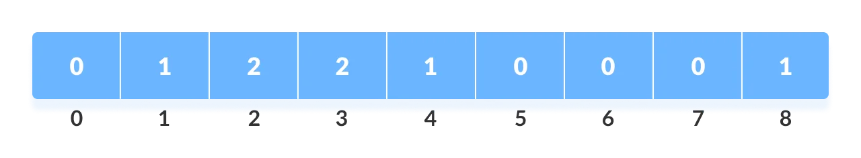
Counting Sort: Example
Find and store the count of each element at their respective index in count array.
For example: if the count of element 3 is 2 then, 2 is stored in the 3rd position of count array. If element "5" is not present in the array, then 0 is stored in 5th position.
Count of each element stored:

Slide 49
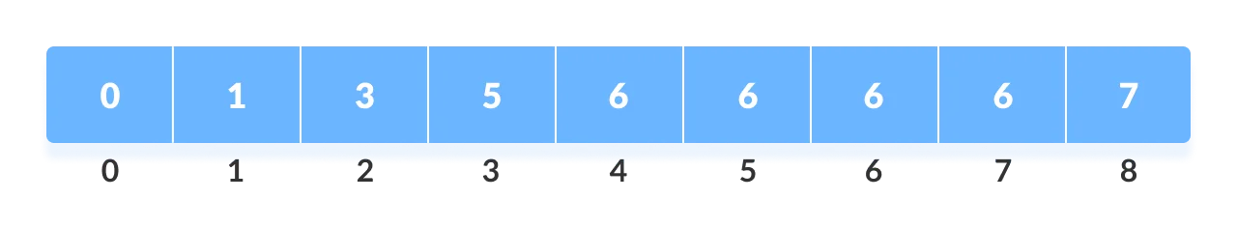
Counting Sort: Example
Store cumulative sum of the elements of the count array. This helps in placing the elements into the correct index of the sorted array.
Cumulative counts :

Slide 50
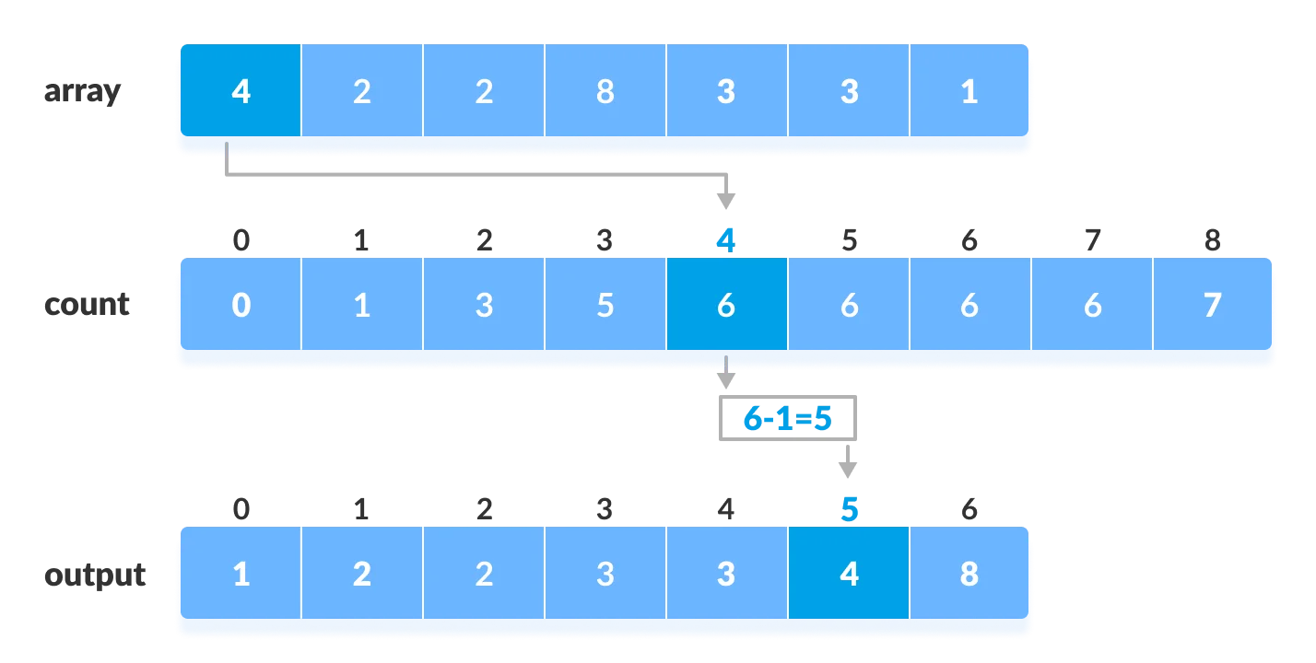
Counting Sort: Example
Find the index of each element of the original array in the count array. This gives the cumulative count. Place the element at the index calculated as shown in figure below.
After placing each element at its correct position, decrease its count by one (Because size is max+1). New array is the output .

Slide 51
Counting Sort Complexity
There are 4 for loops. Let us take max=k
→Complexities of loops: O(k), O(n), O(k), O(n)
Total time: O(n + k) for best, average and worst cases.
Usually, k = O(n)
Thus we can say that counting sort runs in O(n) time.
But, requires O(n+k) extra storage.
Remember comparison sorting is O(n lg n)
No contradiction--this is not a comparison sort (in fact, there are no comparisons at all!)
Notice also that this algorithm is stable
If numbers have the same value, they keep their original order in sorting.

Slide 52
Counting Sort: Discussion
Linear time sort! Cool!
then why don’t we always use counting sort?
Because it depends on the range of elements
Example: Could we use counting sort to sort random 32 bit integers? Why or why not?
Answer: no, k is too large : 2³² = 4,294,967,296
→ It may perform better than comparison based sorting techniques for small integers. But, it is bad if the integers are very large because arrays of that size should be used.

Slide 53
Counting sort function in C+
#include <iostream>
using namespace std;
void countSort(int array[], int size) {
int output[10];
int count[10];
int max = array[0];
// Find the largest element of the array
for (int i = 1; i < size; i++) {
if (array[i] > max)
max = array[i]; }
// Initialize count array with all zeros.
for (int i = 0; i <= max; ++i) {
count[i] = 0;
// Store the count of each element
for (int i = 0; i < size; i++) {
count[array[i]]++; }
// Store the cummulative count of each array
for (int i = 1; i <= max; i++) {
count[i] += count[i - 1]; }
// Find the index of each element in count array, and
// place the elements in output array
for (int i = size - 1; i >= 0; i--) {
output[count[array[i]] - 1] = array[i];
count[array[i]]--; }
// Copy the sorted elements into original array
for (int i = 0; i < size; i++) {
array[i] = output[i]; }
}

Slide 54

Stable Sorting Algorithms
A sorting algorithms is stable if for any two indices i and j with i < j and a_{i} = a_{j}, element a_{i} precedes (comes before) element a_{j} in the output sequence.
→Stable sorting algorithms preserve the relative order of equal elements
Input
2₁
7₁
4₁
4₂
2₂
5₁
2₃
6₁
Output
2₁
2₂
2₃
4₁
4₂
5₁
6₁
7₁
Observation: Insertion, Bubble, Merge and counting sort are stable.
Selection sort and quick sort are not stable!

Slide 55
GOOD DEMO SITES for SORTING
http://math.hws.edu/eck/js/sorting/xSortLab.html
https://www.toptal.com/developers/sorting-algorithms

